Slide 1
Software Development
Street Credibility for Cybersecurity Practitioners

Slide 2
What We Will Discuss
Provide developer perspective – what security looks like
What can help – “Street Credibility”
“lay of the land” in software technologies
Code examples, including exploits
Add real world context to the CISSP section on software

Slide 3
My Background
~20 years of experience in software… By way of finance
Big, Small, and In Between – GE, My own “social network”
Most Professional Work – Java/Oracle/Web
Favorite: Python/Data
Now: Not my day job, but a fun hobby

Slide 4
My Results: CISSP – Chapter 8 Practice Test
70%
(Fail)

Slide 5
A Few Other Things
Notes are optional – not sure how much this will help on the test
I hope it helps when you are out there working
Please ask questions at any time
The test will take some real study
Good breadth and background (Mixed with nitpicking)
Feel free to email me (josh.martin@gmail.com)

Slide 6


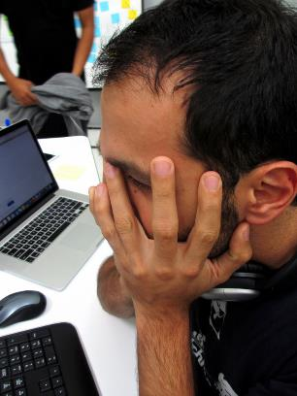
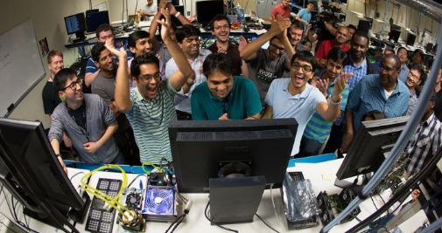

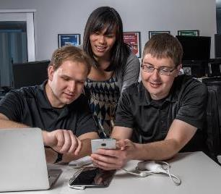
“Street Credibility”
Failure
Success
Nostalgia

Slide 7
Perceptions of Cybersecurity

Slide 8
What COULD help

Slide 9
Software Development 101

Slide 10
Web Technologies

Slide 11
Middleware

Slide 12
The “Backend”

Slide 13
A note on mobile

Slide 14
The Build

Slide 15
Deployment

Slide 16
Testing

Slide 17
The Buzz

Slide 18
Cloud

Slide 19
Agile

Slide 20
DevOps

Slide 21
SECDevOps

Slide 22
Putting It Together
Spin up server
Install Java
Install Tomcat
Install Maven
Install Git (configure Security)
Pull Code We Showed
Build and START

Slide 23
Vulnerability Hunt

Slide 24
YYYYYYYYYYYYY

Slide 25
YYYYYYYYYYYYY

Slide 26
YYYYYYYYYYYYY

